Slide 1
Direct Marketing Campaign Dashboard User Guide
Created by: Chris Matthews

Slide 2
Contents
Introduction
User Guide for Dashboard
1. Dashboard overview
2. Data Visualisation and Interactivity
3. Assumptions and Exclusions
4. Help, Support and Security
Finally

Slide 3
Introduction
This is a user guide for a dashboard built in Tableau based on the recent Direct Marketing Campaign.
This dashboard will aim to:
1) Introduce you how to use the dashboard, including utilising interactions and filters.
2) Explain any ambiguous terminology used in the dashboard.
3) Explain filters and exclusions applied to the source data and any assumptions made.
4) Provide my conclusions and insights on the marketing campaign data.

Slide 4
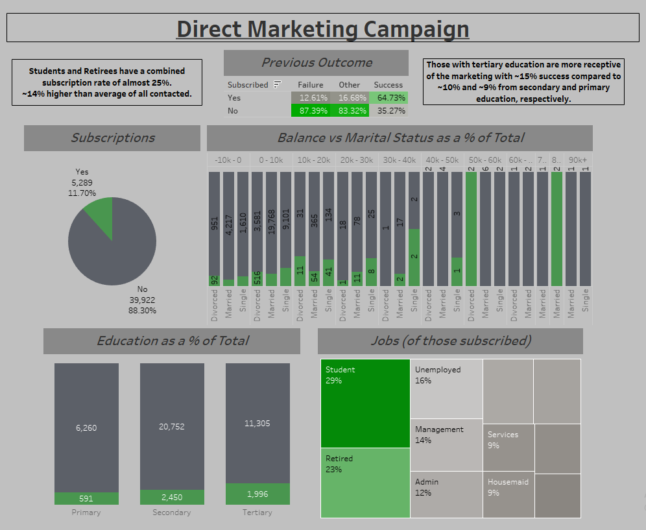
User Guide for Dashboard 1. Dashboard Overview
Link to Dashboard
Welcome to the user guide for the marking campaign dashboard. The following slides will walk you through the features and functionalities of the dashboard.
The direct marketing campaign dashboard provides insights into the types of customers we contacted as part of our marketing campaign as well as those customers types that most frequently subscribed to the offer.

Slide 5
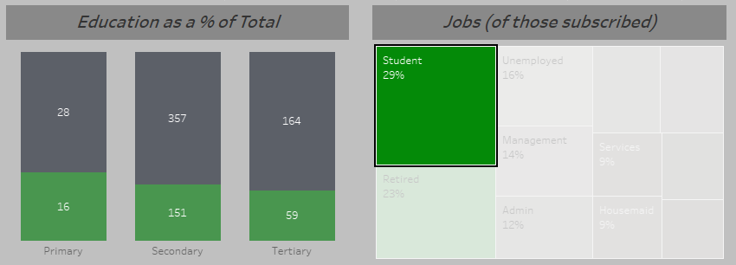
User Guide for Dashboard 2. Data Visualisation and Interactivity
The marketing campaign dashboard presents data in visual formats; pie chart, tree map, stacked column charts and a highlight table. All of these are interactive.
Also on the dashboard is are boxes containing non-interactive text, giving some examples of where the marketing campaign has been particularly successful in comparison to similar areas.
Hovering over the interactive elements of the visuals will provide additional information on that particular segment. By clicking on a particular segment, the dashboard will filter all interactive visuals to reflect your selection.

Slide 6
User Guide for Dashboard 3. Assumptions and Exclusions
No assumptions have been made from the raw data.
All unknowns have been excluded from the dashboard. Unknown values were present within ‘Jobs’ and ‘Education’.
There were no “null” values within the data.
Bins were created from the original dataset to group customers by age and balance.

Slide 7
User Guide for Dashboard 4. Help, Support and Security
If you encounter and difficulties or have any questions about using the dashboard, you can contact the dashboard creator for assistance. The creator is available to address any issues or provide guidance on using the dashboard effectively.
Please remember to close the dashboard once you have finished exploring to maintain the security of the data.

Slide 8
Finally
I hope this guide helps you navigate and utilise the dashboard effectively to support your understanding, goals and objectives. If you have any further questions, requests or feedback, do not hesitate to reach out.

